Slide 1
Threading using C# and .NET
Information Processing Techniques
Week 08

Slide 2
Threads
Thread is the fundamental unit of execution.
More than one thread can be executing code inside the same process (application).
On a single-processor machine, the operating system is switching rapidly between the threads, giving the appearance of simultaneous execution.

Slide 3
With threads you can
Maintain a responsive user interface while background tasks are executing
Distinguish tasks of varying priority
Perform operations that consume a large amount of time without stopping the rest of the application

Slide 4
Threading: Advantages and Dangers
Main
Thread
Reasons to use Threading
Timers
UI Responsiveness
Multiple processors
Dangers
Race Conditions
Deadlock
Child
Thread
Notes:
if (x == 5) // The "Check" {
y = x * 2; // The "Act"
// If another thread changed x in between "if (x == 5)" and "y = x * 2" above,
// y will not be equal to 10. }

Slide 5
Race Condition
if (x == 5) // t0 and t1 {
y = x * 2; // The "Act"
// If another thread changed x in between "if (x == 5)" and "y = x * 2" above,
// y will not be equal to 10. }

Slide 6
Spawning a new Thread
IO
Delegates
System.Thread

Slide 7
System. Threading Namespace
Provides classes and interfaces that enable multithreaded programming.
Consists of classes for synchronizing thread activities .
Chief among the namespace members is Thread class

Slide 8
Thread Class
Implements various methods & properties that allows to manipulate concurrently running threads.
Some of them are :
CurrentThread
IsAlive
IsBackground
Name
Priority
ThreadState

Slide 9
Thread Constructor
Takes a ThreadStart delegate
ThreadStart(void () target)
Takes a method which returns void and has no params:
void MyMethod()
Thread begins execution when Start() is called
Thread executes method passed to ThreadStart

Slide 10
Thread Properties
IsBackground
get or set
Once all foreground threads are finished, the runtime calls Abort on all background threads
Default is false (or foreground)
Priority
ThreadPriority Enum
Lowest, BelowNormal, Normal, AboveNormal, Highest
ThreadState
New Thread: ThreadState.Unstarted
Started Thread: ThreadState.Running
Sleep called: ThreadState.WaitSleepJoin
Suspend called: ThreadState.Suspended
See ThreadState Enumeration

Slide 11
Thread Methods
Start()
Begins execution of the thread
Once a thread is finished, it cannot be restarted
Suspend()
Suspends the thread
If the thread is already suspended, there is no effect
Resume()
Resumes a suspended thread
Interrupt()
Resumes a thread that is in a WaitSleepJoin state
If the thread is not in WaitSleepJoin state it will be interrupted next time it is blocked

Slide 12
Thread Methods (Continued)
Abort()
Attempts to abort the thread
Throws a ThreadAbortException
Join()
Blocks the calling thread until the owning thread terminates
Sleep()
Suspends the current thread for the specified amount of time

Slide 13
Exceptions Between threads
Must be handled in the thread it was thrown in
Exceptions not handled in the thread are considered unhandled and will terminate that thread

Slide 14
Starting a Thread
Thread thread = new Thread(new ThreadStart (ThreadFunc));
//Creates a thread object
// ThreadStart identifies the method that the thread executes when it
//starts
thread.Start();
//starts the thread running
Notes:
The parameter of the Thread class is reference to a ThreadStart class. ThreadStart class points to the method that should be executed first when a thread is started.

Slide 15
Suspending and Resuming Threads
Thread.Suspend temporarily suspends a running thread.
Thread.Resume will get it running again
Sleep : A thread can suspend itself by calling Sleep.
Difference between Sleep and Suspend
A thread can call sleep only on itself.
Any thread can call Suspend on another thread.

Slide 16
Terminating a thread
Thread.Abort() terminates a running thread.
In order to end the thread , Abort() throws a ThreadAbortException.
Suppose a thread using SQL Connection ends prematurely , we can close the the SQL connection by placing it in the finally block.
- SqlConnection conn ………
try{
conn.open();
….
.....
}
finally{
conn.close();//this gets executed first before the thread ends.
}

Slide 17
ResetAbort / Join
A thread can prevent itself from being terminated with Thread.ResetAbort.
- try{
…
}
catch(ThreadAbortException){
Thread.ResetAbort();
}
Thread.Join()
When one thread terminates another, wait for the other thread to end.

Slide 18
Synchronization Classes and Constructs
lock keyword
Mutex class
Monitor class
Interlocked class

Slide 19
Monitor Class (static)
Enter(object obj)
Begins a critical section
Blocks if another thread has the same lock
Exit(object obj)
Ends a critical section
Releases the lock
TryEnter(object obj)
Returns true if it obtains the lock
Returns false if it can’t obtain the lock
Avoids blocking if you can’t obtain the lock
Wait(object obj)
Releases the lock on an object and blocks until it reaquires the lock
Pulse(object obj)
Signals the next waiting thread that the lock may be free
PulseAll(object obj)
Signals all waiting threads that the lock may be free

Slide 20
Thread Synchronization / Monitors
Thread Synchronization
Threads must be coordinated to prevent data corruption.
Monitors
Monitors allow us to obtain a lock on a particular object and use that lock to restrict access to critical section of code.
While a thread owns a lock for an object, no other thread can acquire that lock.
Monitor.Enter(object) claims the lock but blocks if another thread already owns it.
Monitor.Exit(object) releases the lock.

Slide 21
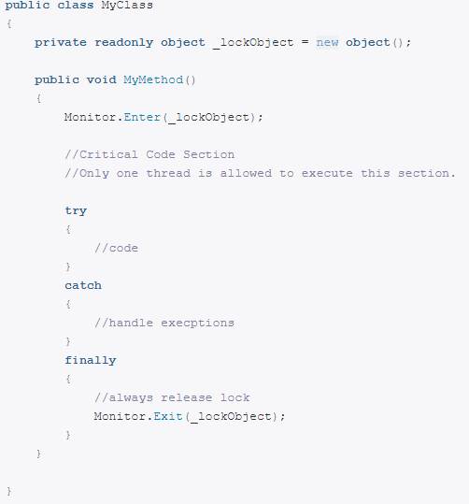
Skeleton Code: Monitor

Slide 22
The lock Keyword
Marks a statement as a critical section
Is a Monitor underneath
Example:
lockObject must be a reference-type instance
Typically you will lock on:
‘this’
locks the current instance
typeof(MyClass)
global lock for the given type
A collection instance
locks access to a specific collection
lock(lockObject) {
// critical section }

Slide 23
The lock Mutex
lock defines one Mutex for each object locked on
Blocks until the current thread is finished

Slide 24
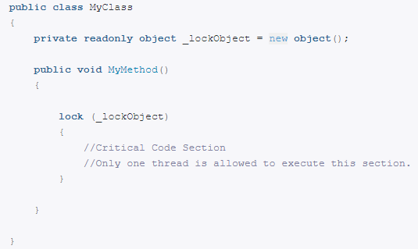
Skeleton Code: lock

Slide 25
The C # Lock Keyword :
lock(buffer){ ……. }
is equivalent to
Monitor.Enter(buffer); try { critical section; } finally { Monitor.Exit(buffer); }
Makes the code concise.
Also ensures the presence of a finally block to make sure the lock is released.
Notes:
Finally block is there but can’t be seen. It is automatically generated in the CIL statements.

Slide 26
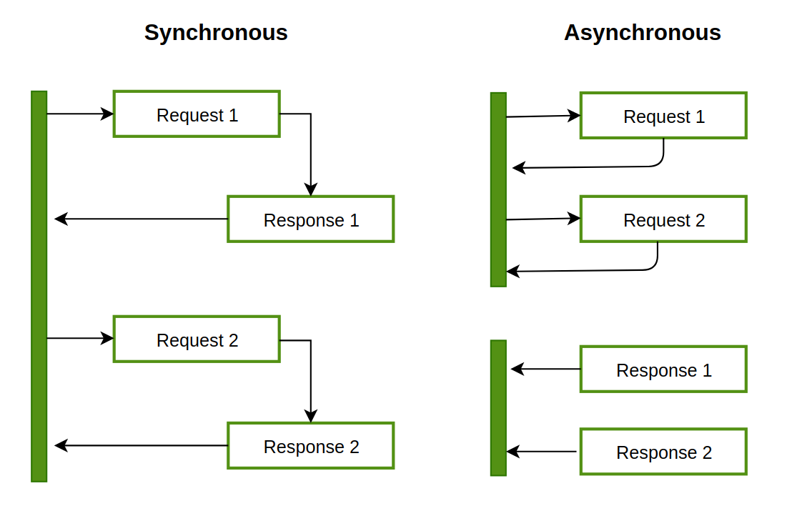
Sync v/s ASync

Slide 27
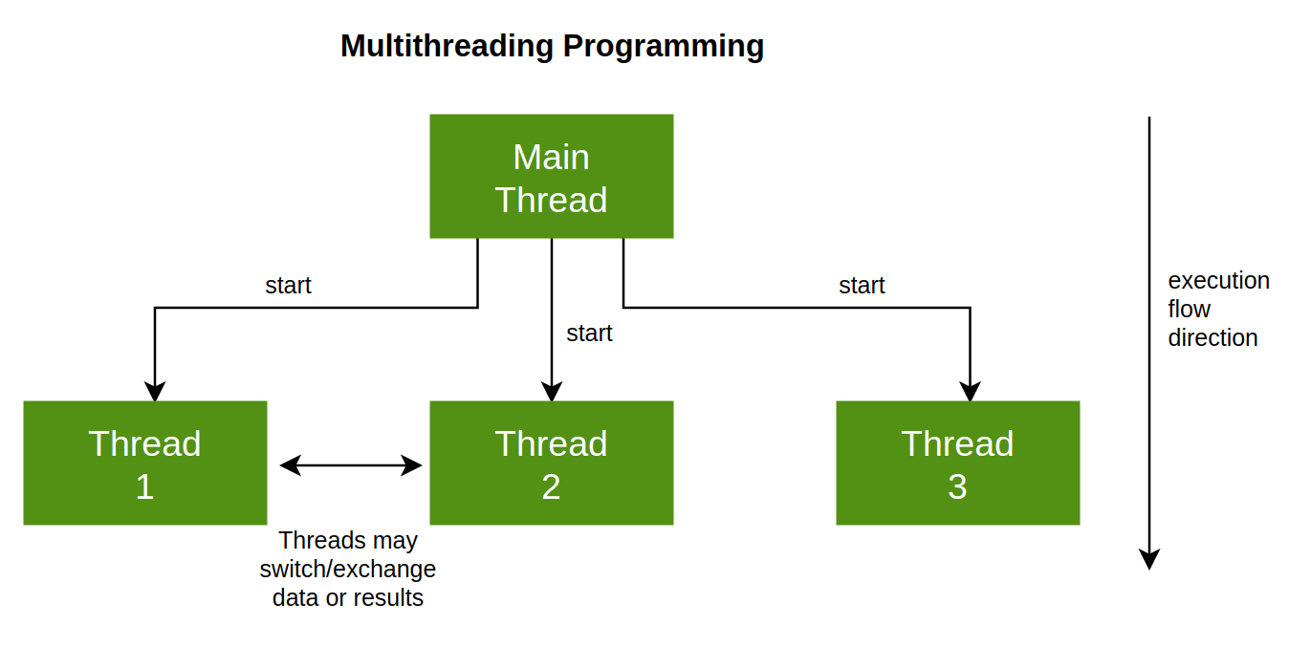
Multithreading
Notes:
Egg and Bread

Slide 28
Reading on ASync
Asynchronous programming in C# | Microsoft Docs (https://docs.microsoft.com/en-us/dotnet/csharp/programming-guide/concepts/async/)

Slide 29
Conclusion
Using more than one thread, is the most powerful technique available to increase responsiveness to the user and process the data necessary to get the job done at almost the same time.

